Slide 1
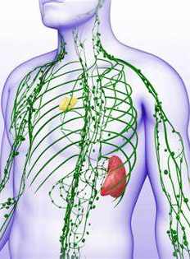
The Lymphatic System
AEHBY ATAR Human Biology

Slide 2
Review
State one function of each of these organelles:
a) ribosome
b) lysosome
c) mitochondria
d) rough endoplasmic reticulum
e) smooth endoplasmic reticulum

Slide 3
Review
2. Give an example of a substance that would be transferred across the cell membrane using each of these mechanisms:
a) simple diffusion
b) osmosis
c) facilitated diffusion
d) active transport

Slide 4
Review
3. Name the macromolecule (biomolecule) that is built from each of these monomers:
a) amino acid
b) saccharide (simple sugar)
c) nucleotide
e) fatty acid and glycerol

Slide 5
Review
4. Compare the structure and function of arteries, capillaries and veins.

Slide 6
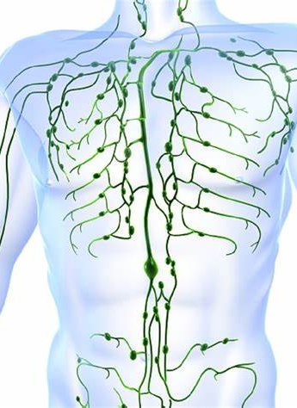
Learning Intentions
The lymphatic system functions to return tissue fluid to the circulatory system and to assist in protecting the body from disease

Slide 7
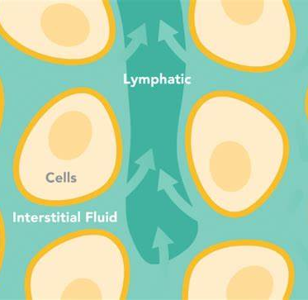
Success Criteria
Briefly describe the three functions of the lymphatic system.
Define lymph and compare its composition to blood, plasma and interstitial fluid.
Locate major lymphatic ducts and trunks on an anatomical diagram (do not have to remember their names).
Explain the function of lymph nodes and lymphoid organs, such as the spleen, thymus and tonsils.

Slide 8
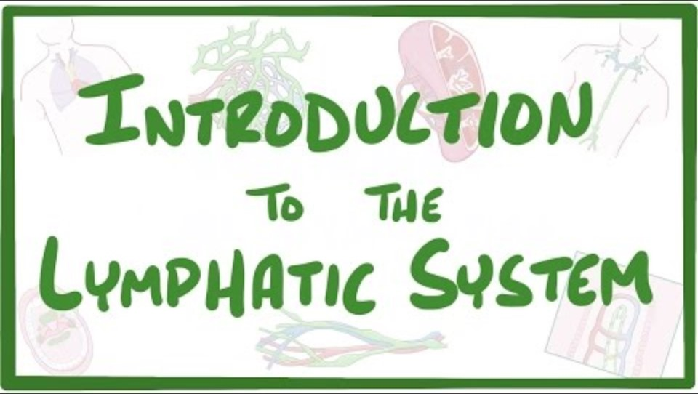

Slide 9
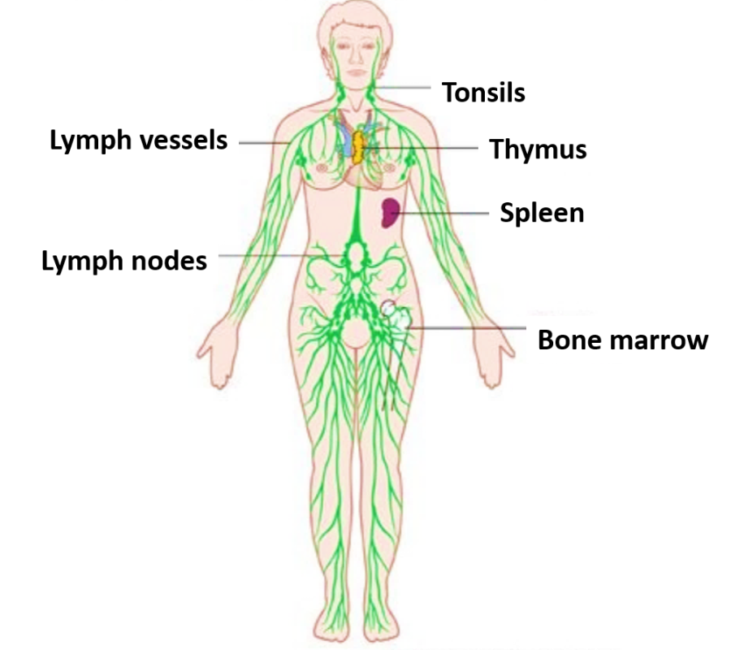

Slide 10
Questions:
List the three main functions of the lymphatic system.
What is lymph? How does it compare to blood, plasma and interstitial fluid, in terms of location and composition.
Explain how lymphatic mini-valves work.
The lymphatic system has no pump. Explain how lymphatic fluid is moved around the body.
Explain why molecules such as hormones and chylomicrons are unable to move through capillaries.
Name the type of white blood cells that are associated with the lymph nodes and lymphoid organs.
Name three lymphoid organs and state where in the body they are located.
How does the spleen keep blood ‘fresh and new’?
What are lymph nodes and what is their main function?
What are tonsils and what is their main function?

Slide 11
Success Criteria
Briefly describe the three functions of the lymphatic system.
Define lymph and compare its composition to blood, plasma and interstitial fluid.
Locate major lymphatic ducts and trunks on an anatomical diagram (do not have to remember their names).
Explain the function of lymph nodes and lymphoid organs, such as the spleen, thymus and tonsils.

